Slide 1
Radius and Interval of Convergence for Power Series
Rizzi – Calc BC

Slide 2
Review: Convergence of Geometric Series
For what values of x will the following geometric series converge?

Slide 3
Recall: Power Series
A power series is an infinite polynomial representation of a function that involves increasing powers of x.

Slide 4
Convergence of a Power Series
Convergence refers to the accuracy of the polynomial for any x value
A power series centered at c can do one of three things:
The series converges only at c
The series converges over a specific interval $(c−R, c+R)$This is the “interval of convergence”
The series converges for all x

Slide 5
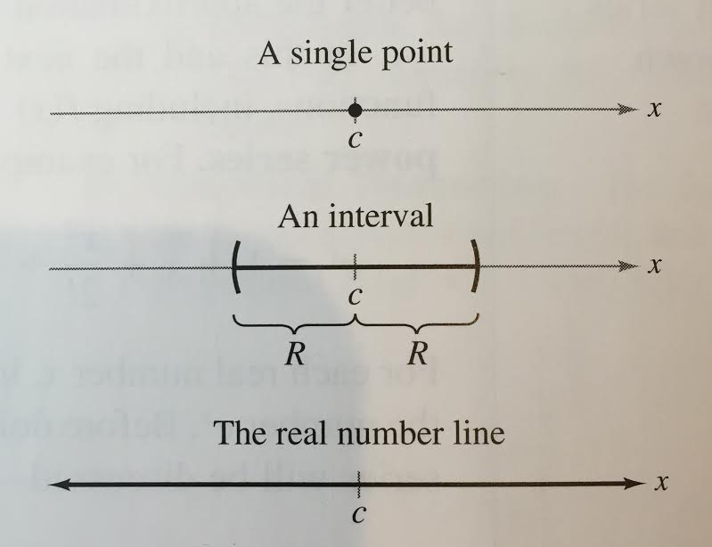
Visual Representation
The series converges only at c
The series converges over a specific interval $(c−R, c+R)$…This is the “interval of convergence”
The series converges for all x

Slide 6
Finding an Interval of Convergence
Use the ratio test to determine where the function converges.
Taking the limit as n goes to infinity, we can solve for x by setting the resulting expression < 1. This tells us the radius of convergence.
Set up an interval by finding where the series is centered.
Test the endpoints separately for convergence. This is important!!

Slide 7
Try it!
Find the interval of convergence of the following summation:
Use the ratio test
Find the radius of convergence.
Set up an interval. (Where is the series centered?)
Test the endpoints by plugging them in for x.

Slide 8
Try it!
Find the interval of convergence of the following summation:
Use the ratio test
Find the radius of convergence.
Set up an interval. (Where is the series centered?)
Test the endpoints by plugging them in for x.

Slide 9
Try it!
Find the interval of convergence of the following summation:
Use the ratio test
Find the radius of convergence.
Set up an interval. (Where is the series centered?)
Test the endpoints by plugging them in for x.
Converges for all x

