Slide 1
Lagrange Error Bound (AKA Lagrange Form of the Remainder)
Rizzi – Calc BC

Slide 2
Warm Up
Find the fifth degree Maclaurin polynomial for sin(x) and use it to approximate sin(1)
How much error is involved in this approximation?

Slide 3
Remainder
When a Taylor polynomial is used to approximate a function, we need a way to see how accurately the polynomial approximates the function
In English:

Slide 4
Two Cases for Remainder
Taylor Polynomial is alternating
The first omitted term (or $a_{n+1}$) is the upper bound on the error
Taylor Polynomial is nonnegative
Lagrange Remainder
Again, we are only concerned with an upper bound on the error (or maximum error)

Slide 5
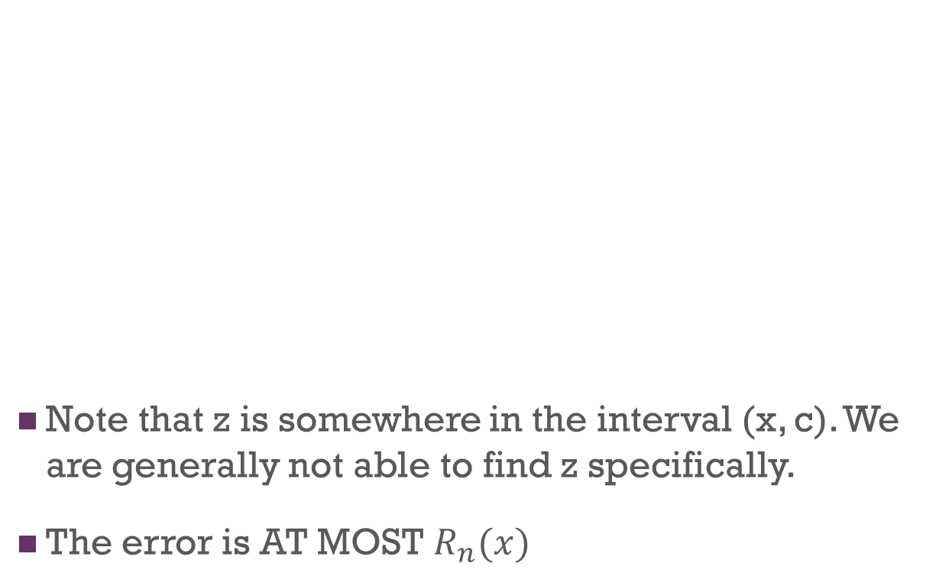
Taylor’s Theorem and Lagrange
Note that z is somewhere in the interval (x, c). We are generally not able to find z specifically.
The error is AT MOST $R_{n}(x)$

Slide 6
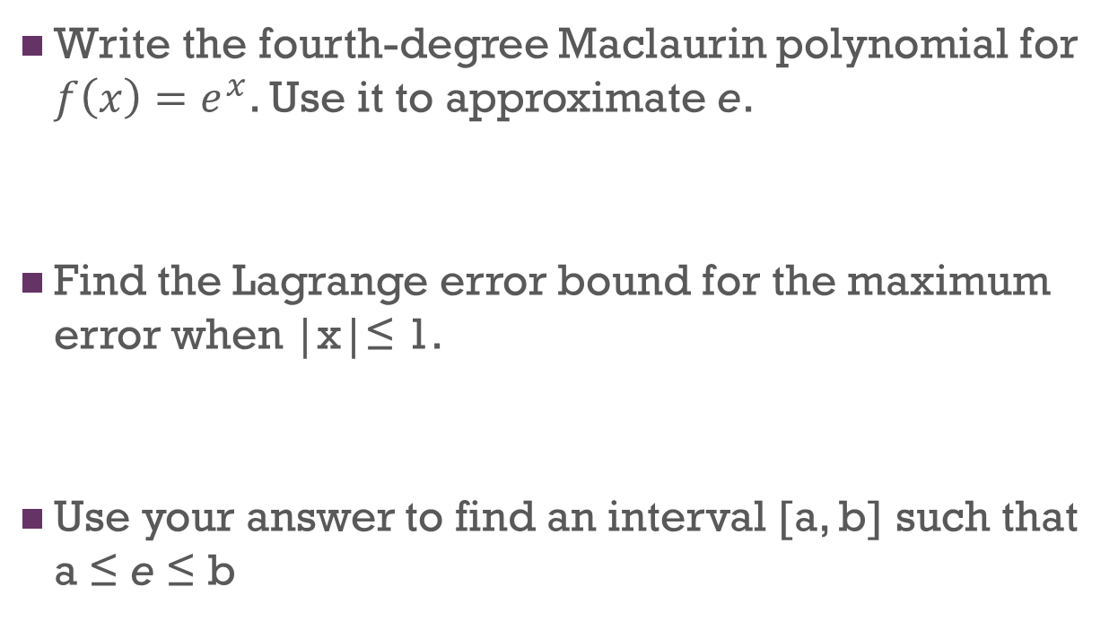
Application
Write the fourth-degree Maclaurin polynomial for $f\left(x\right)=e^{x}$. Use it to approximate e.
Find the Lagrange error bound for the maximum error when |x|≤ 1.
Use your answer to find an interval [a, b] such that a ≤ e ≤ b

