Slide 1
Taylor and Maclaurin Polynomials
Rizzi – Calc BC

Slide 2
Review
Use a tangent line approximation to approximate sin(0.2)
Can we come up with a better approximation than this?

Slide 3
Tangent Line Approximations
The tangent line approximation just implies that the function and first derivative values are the same.
Can we do better than this?

Slide 4
Taylor Polynomials
We can build a polynomial approximation for sin(x) by setting successive derivatives equal to each other like this:

Slide 5
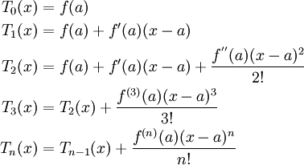
General Formula for Taylor Polynomials

Slide 6
Try it!
Find a fourth degree Taylor polynomial centered at c = 1 for f(x)=ln(x)
How is this one different?

Slide 7
One More!
Suppose that g is a function which has continuous derivatives and that g(2)=3, g’(2)=-4, g’’(2)=7, and g’’’(2)=-5. Write the Taylor polynomial of degree 3 for g centered at 2.
Hint:

