Slide 1
7-2 Solids of Revolution
Rizzi – Calc BC

Slide 2
Um…what?
A region rotated about an axis creates a solid of revolution
Visualization

Slide 3
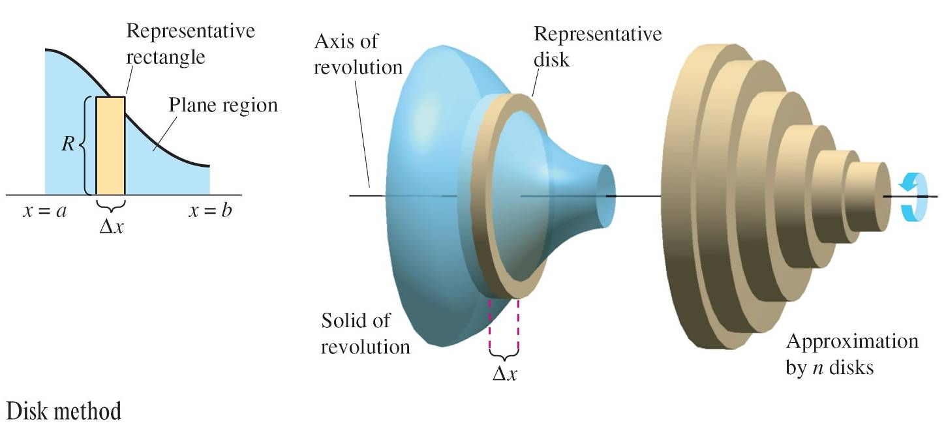
Formula for Basic Rotation
The formula for the volume of these solids is pretty intuitive

Slide 4
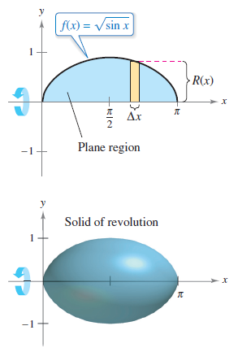
Disk Method
Find the volume of the solid formed by revolving the region bounded by the graph of $f\left(x\right)=\sqrt{sinx}$ and the x-axis about the x-axis.

Slide 5
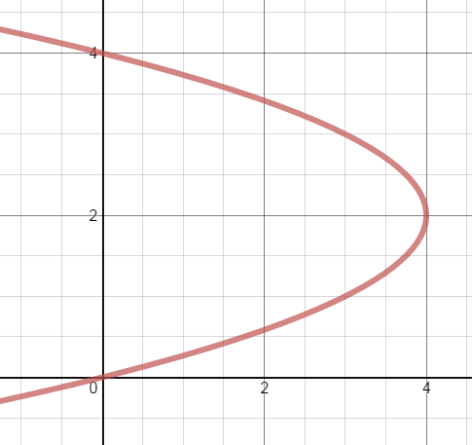
Disk Method with Respect to y
Find the volume of the solid formed by revolving the region bounded by the graph of $x=−y^{2}+4y$ and the y-axis about the y-axis.

Slide 6
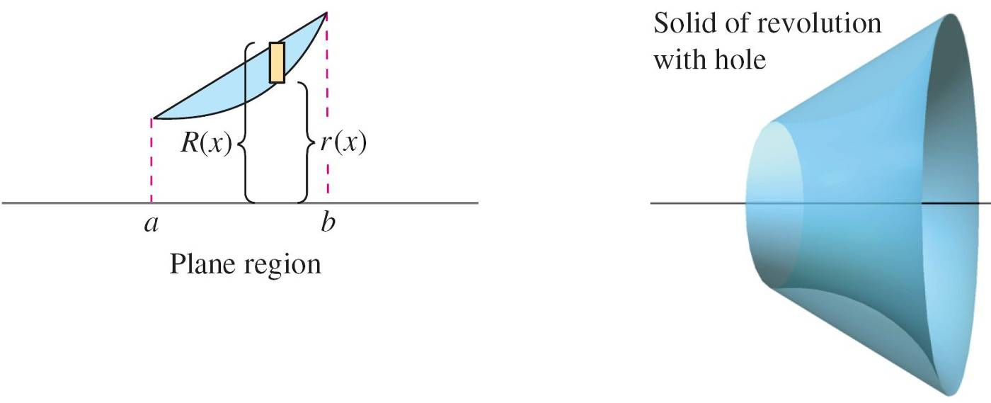
Uh oh!
What happens when the region is not totally backed up to the axis of revolution?

Slide 7
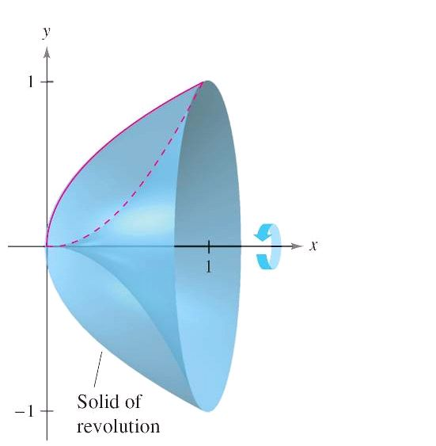
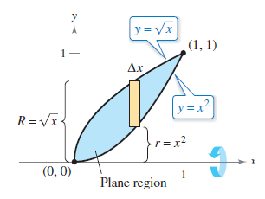
Washer Method Around an Axis
Find the volume of the solid formed by revolving the region bounded by the graphs about the x-axis.

Slide 8
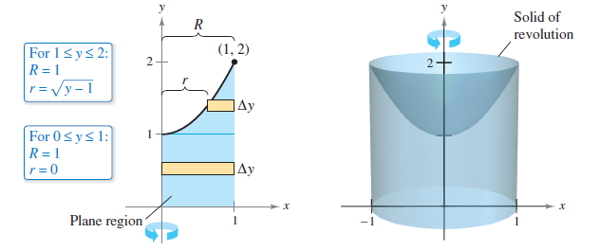
About the y-axis
Find the volume of the solid formed by revolving the region bounded by the graphs of y = x² + 1, y = 0, x = 0, and x = 1 about y-axis.

Slide 9
Homework
7.2 #1, 5, 9, 31, 35, 39
All UT except 22, 23, 27

Slide 10
7-2 Solids of Revolution and Solids with Known Cross Sections
Rizzi – Calc BC

Slide 11
AP Warm Up – 1985 bc
A

Slide 12
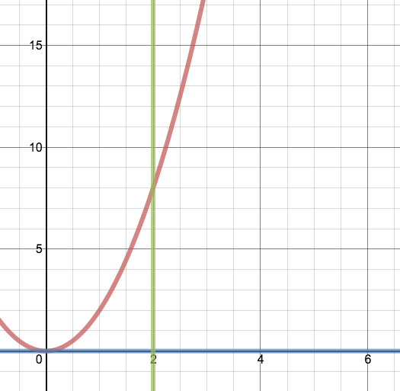
Solids Revolved Around a Line
Find the volume of the solid generated by revolving the region bound by y = 2x², y = 0, and x = 2 around
(a) the line y = 8
(b) the line x = 3

Slide 13
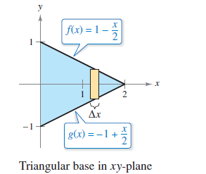
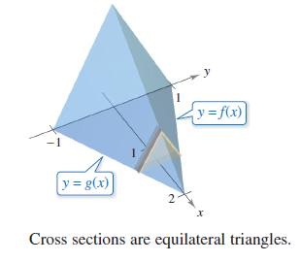
Solids with Known Cross Sections
Example:

Slide 14
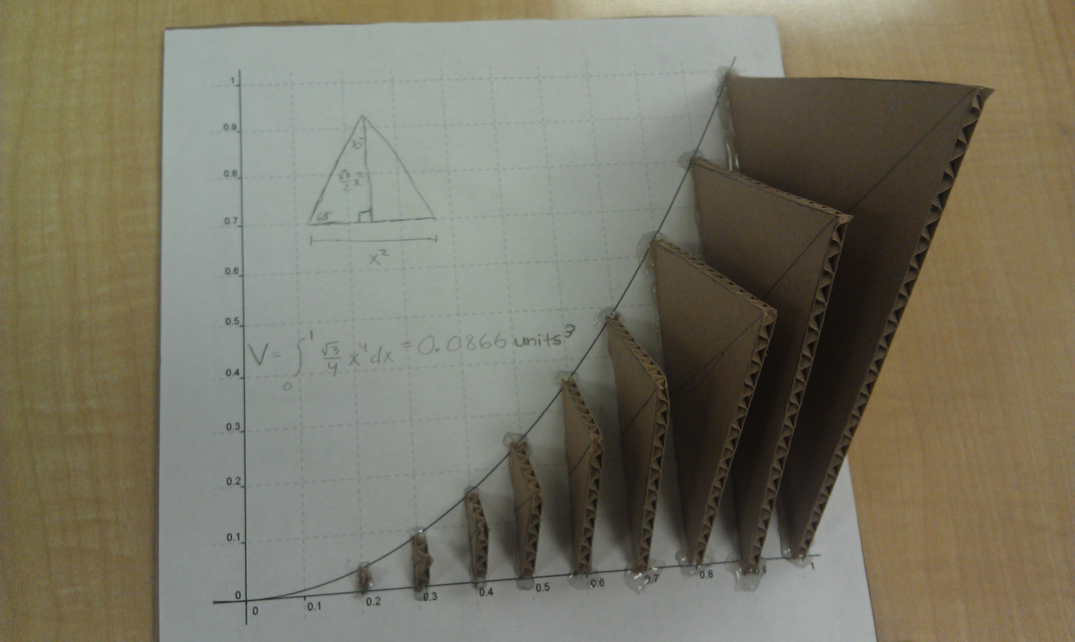

Slide 15
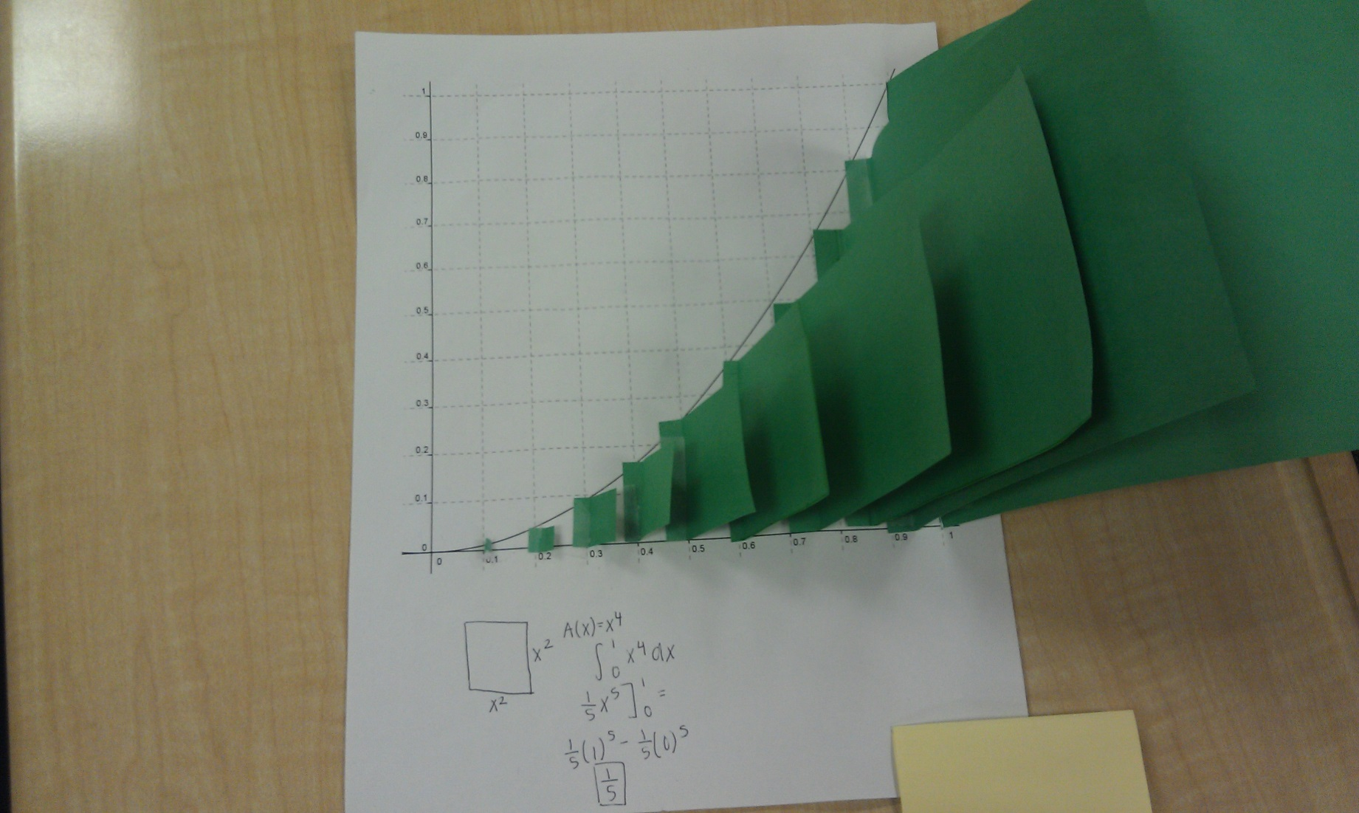

Slide 16
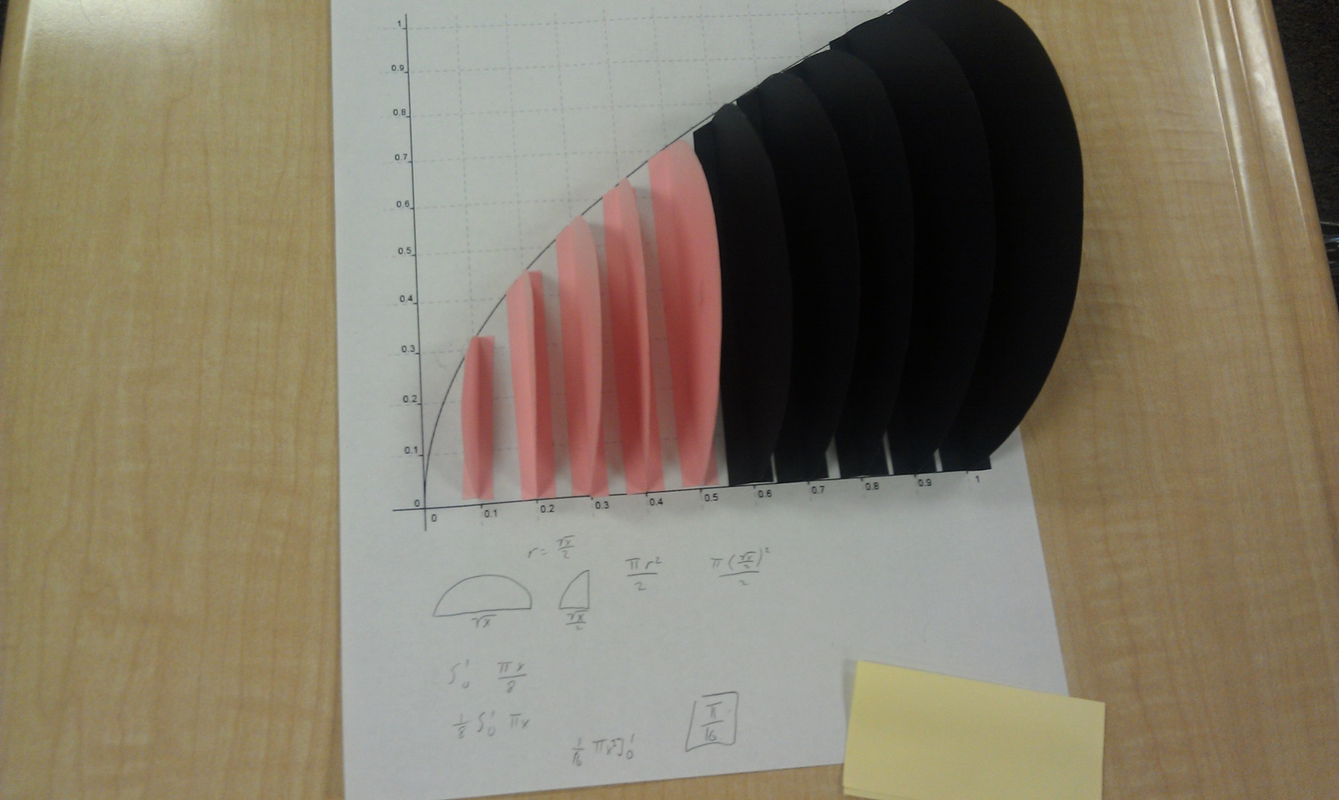

Slide 17
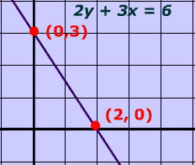
Cross Sections Perpendicular to y-axis
Find the volume if the cross sections perpendicular to the y-axis of a right triangle are semicircles.

Slide 18
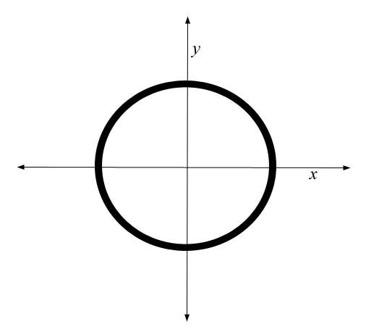
Cross Sections Perpendicular to x-axis
Find the volume of the solid whose base is bounded by the circle x² + y² = 4. The cross sections perpendicular to the x-axis are squares.

Slide 19
Ap Practice

Slide 20
Homework
7.2 #11, 13, 17, 21, 54, 71 (washer method practice)
Worksheet (Solids with known cross sections)

