Slide 1
4-5 Integration by Substitution for Indefinite Integrals
Rizzi – Calc BC

Slide 2
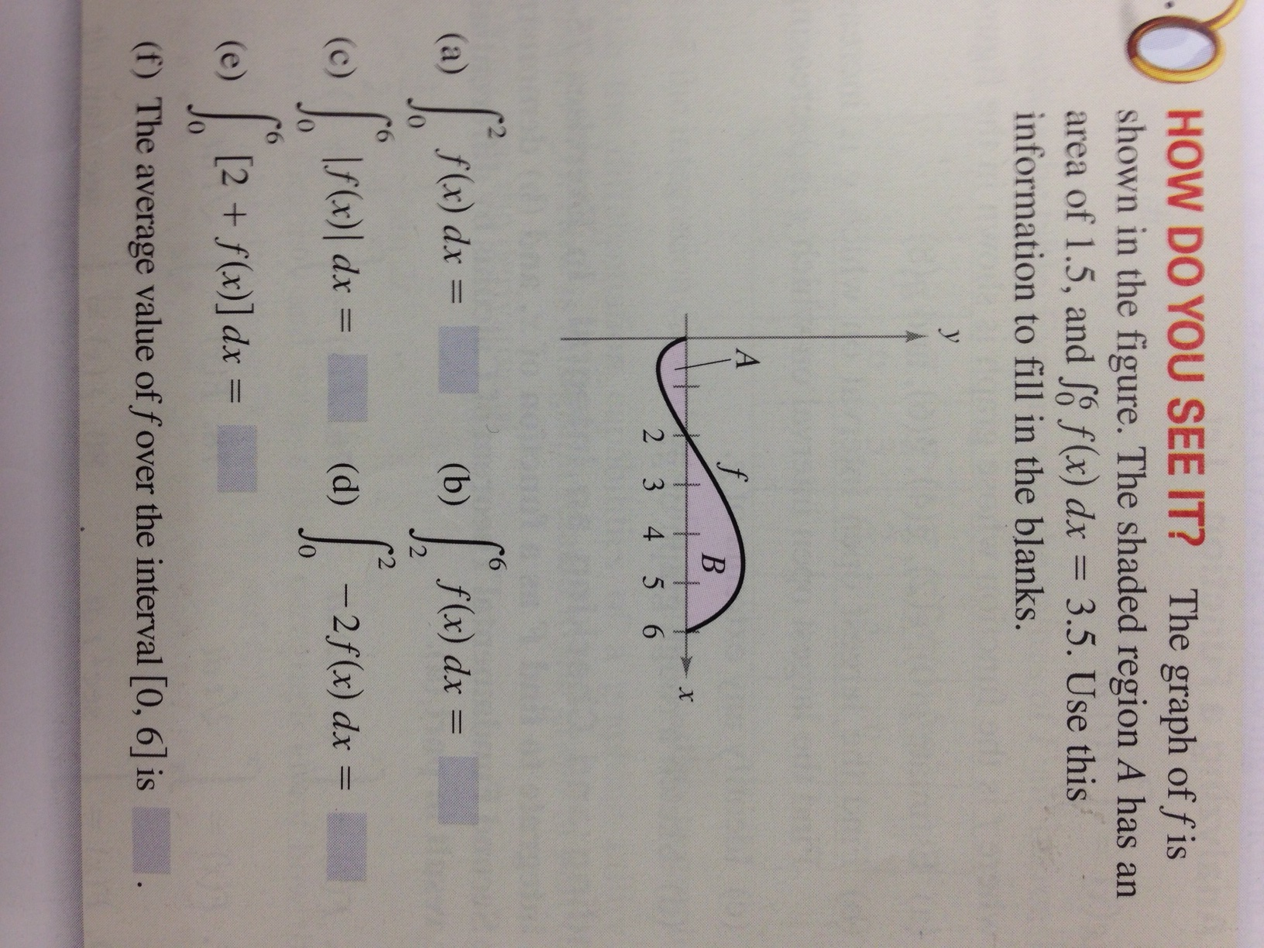
Warm Up

Slide 3
Composite Functions
Sometimes we have to integrate more complicated functions
We need to recognize the chain rule pattern in these functions:
$$\int{{\left(x^{2}+1\right)}^{2}\left(2x\right)dx}$$
$$\int{5cos⁡(5x) dx}$$
$$=\frac{1}{3}{\left(x^{2}+1\right)}^{3}+C$$
$$=\sin\left(5x\right)+C$$

Slide 4
Change of Variables
Sometimes these bad boys get way too complicated, though…
$$\int{\sqrt{2x−1}dx}$$
$$=\frac{1}{3}{\left(2x−1\right)}^{\frac{3}{2}}+C$$

Slide 5
Change of Variables with the Trigs…
$$\int{\sin^{2}{3x}cos3x dx}$$
$$=\frac{1}{9}\sin^{3}{3x}+C$$

Slide 6
U-Sub with More Complex functions
$$\int{−\frac{4x}{{\left(1−2x^{2}\right)}^{2}}dx}$$
$$=−\frac{1}{1−2x^{2}}+C$$

Slide 7
Sometimes U-Subs won’t work
$$\int{{\left(x^{2}+1\right)}^{2}dx}$$

Slide 8
Homework
Complete as many problems on the worksheet as you can
I will check 10 random problems tomorrow. You will receive a HW score out of 5 points.
Your answer must be TOTALLY correct for you to earn the point. Include all work on a separate piece of paper, but put answers on main worksheet.
NOT ALL REQUIRE U-SUB. ALSO SKIP #908

Slide 9
4-5 Integration by Substitution for Definite Integrals
Rizzi – Calc BC

Slide 10
Definite Integrals with u-Sub
$$\int_{0}^{1}{x{\left(x^{2}+1\right)}^{3}dx}$$
$$=\frac{15}{8}$$

Slide 11
Definite Integrals with u-Sub
$$\int_{1}^{5}{\frac{x}{\sqrt{2x−1}}dx}$$
$$=\frac{16}{3}$$

Slide 12
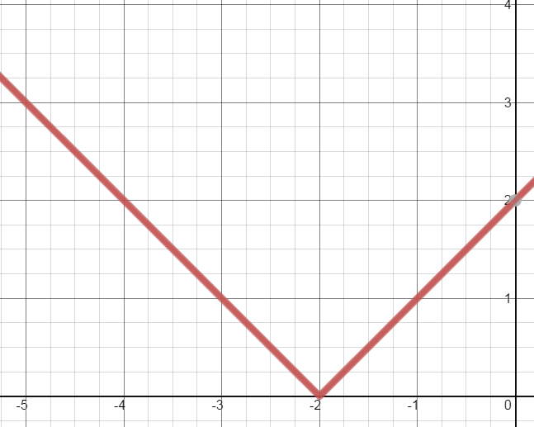
Integrating Absolute Values
$$\int_{−5}^{0}{\left|x+2\right| dx}$$
$$=6.5$$

Slide 13
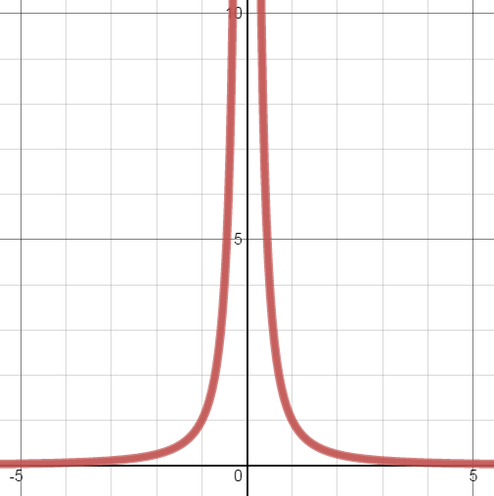
Non-Integrable Functions
For some functions, it’s easy to find the antiderivative, but evaluating it over a closed interval is impossible:
$$\int_{−1}^{1}{\frac{1}{x^{2}}dx}$$

Slide 14
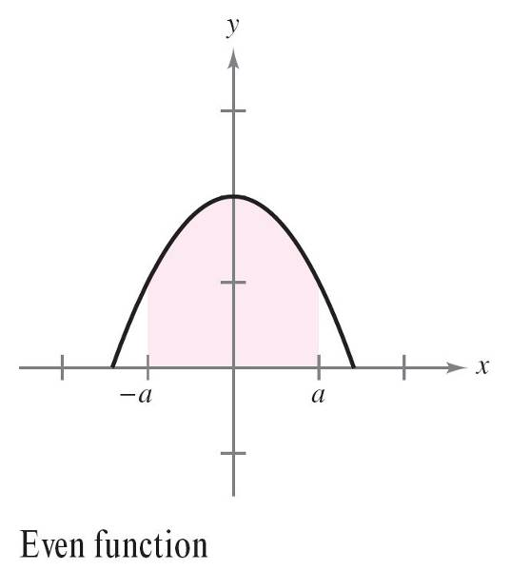
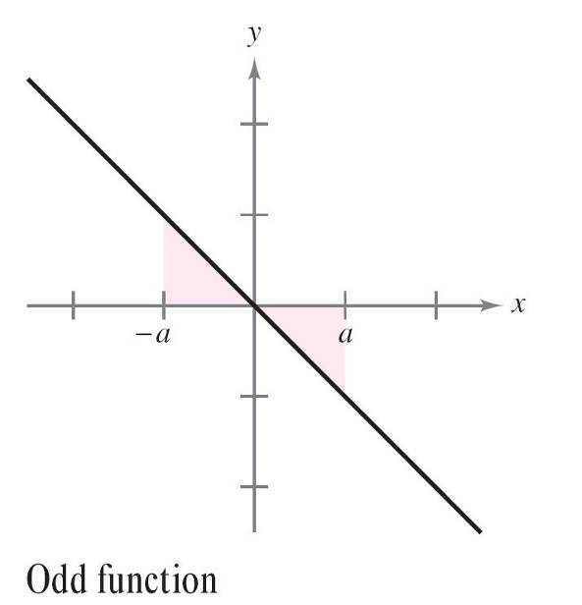
Review: Even and Odd Functions

Slide 15
Integration of Even Functions

Slide 16
Integration of Odd Functions

