Slide 1
Comparison of 1st and 2nd Derivative
 | =0 | Intervals | Extrema Test
1st Derivative | Critical Points (m=0) | Increasing/ Decreasing | Use critical points and intervals of increasing/decreasing
2nd Derivative | Inflection Points (concavity changes) | Concave Up/Down | Use critical points and concavity

Slide 2
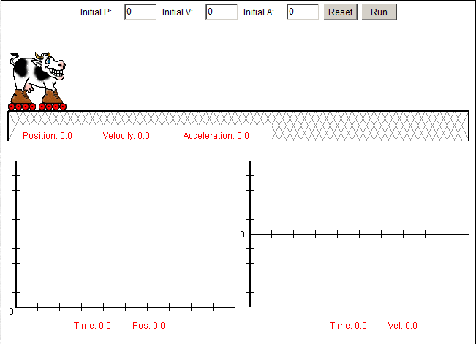
Moo Motion

Slide 3
Particle Motion and Curve Sketching
Rizzi – Calc BC

Slide 4
Position, Velocity, and Acceleration
s(t) tells us position
v(t) tells us velocity (how fast/what direction)
a(t) tells us acceleration (changing speed/what direction)
Speed is velocity (minus direction)
Objects speed up if velocity and acceleration work in the same direction (ie, both positive or both negative)
Objects slow down if velocity and acceleration work in opposite directions (ie, one is negative and one is positive)

Slide 5
Particle Motion
A particle is moving along a horizontal line with position function as given. Find the following:
Intervals where the particle is moving right and left
When the particle is stopped
Intervals where the particle is speeding up and slowing down

Slide 6
Curve Sketching
Use what you know about algebra and calculus to sketch the graph of the following curve. You will have to rely on your knowledge of:
Factoring
x- and y-intercepts
Critical points
Intervals of increasing/decreasing
Relative extrema
Intervals of concavity
Points of inflection

Slide 7
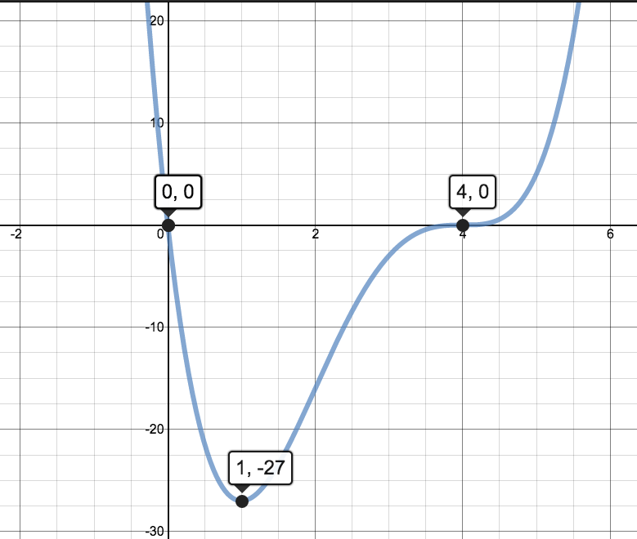

Slide 8
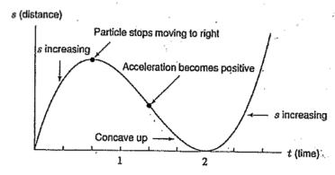
Particle Motion Review Question
When is the particle moving to the right? To the left?
Describe the acceleration of the particle. When is it speeding up? Slowing down?

Slide 9
Homework
3.6 #1-5 all, 19, 37, 49, 51
A particle is moving along a horizontal line with position function as given. Find the following.
When particle is moving right or left.
When the particle is stopped.
When the particle is speeding up or slowing down.
1. $s\left(t\right)=−t^{3}+9t^{2}−24t+ 1$
2. $s\left(t\right)=t+ \frac{9}{t+1}+1$

