Slide 1
Extrema on an Interval
Rizzi – Calc BC

Slide 2
Topic Round-up
Limits
Intermediate Value Theorem
Tangent Line
Average Rate of Change (AROC)
Instantaneous Rate of Change (IROC)
Strategies for Taking Derivatives
Implicit Differentiation
Related Rates

Slide 3
Extrema
“Extrema” refers to maximum and minimum values of a function
Absolute Extrema | Relative Extrema
Definitive maximum or minimum over: A given interval or The entire graph | Maximum or minimum on a given open interval (not necessarily the whole graph)

Slide 4
Absolute Extrema
Can occur on the endpoints OR the interior of a CLOSED interval

Slide 5
This is an EXISTENCE THEOREM!

Slide 6
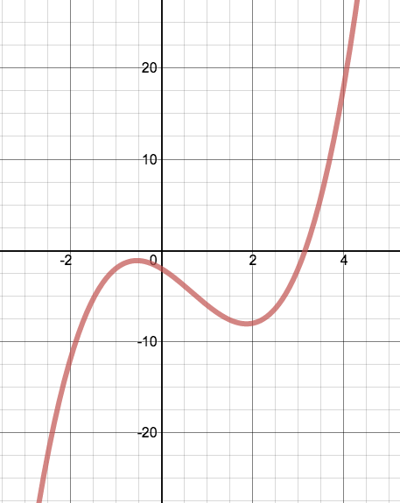
Relative Extrema
Occur in a given neighborhood, but aren’t necessarily the total max or min of a function
Called local min and max

Slide 7
Critical Numbers
Let f be defined at c. If f’(c) = 0 or if f is not differentiable at c, then c is a critical number of f.
In English, critical numbers occur when either:
***Relative extrema occur ONLY at critical numbers***

Slide 8
Example – Extreme Value Theorem
Find the absolute maximum and minimum value of f on the interval [-1, 3]
Steps:
Find critical numbers in (-1, 3)
Evaluate f at each critical number in (-1, 3)
Evaluate f at each endpoint of [-1, 3]
The least value is the min. Greatest is the max.

Slide 9
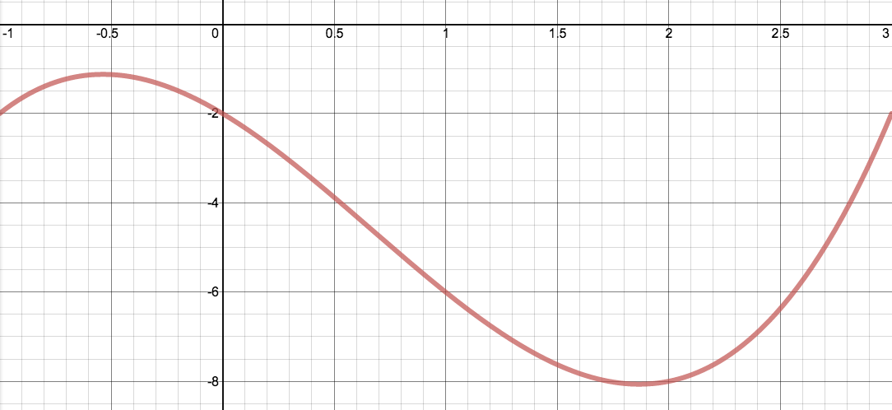
on [-1, 3]

Slide 10
Try it – Extreme Value Theorem
Find the extrema of the function on [0, 2π]

Slide 11
Practice AP MC - 1993
C

