Slide 1
Infinite Limits
Rizzi – Calc BC

Slide 2
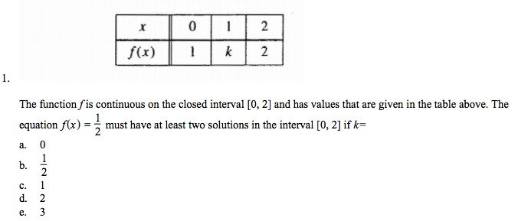
Ap Review - IVT

Slide 3
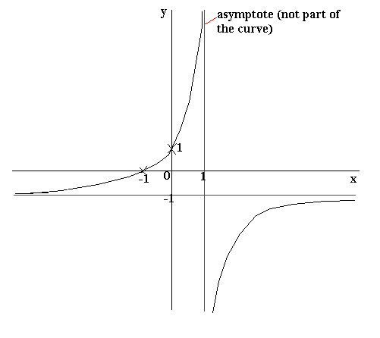
Infinite Limits - Terminology
Increasing without bound
Decreasing without bound
“Infinity”
DNE

Slide 4

Numerical Approach
Use table feature on GC to determine limit of
$$h\left(x\right)=−\frac{1}{x−1}$$

Slide 5
Vertical Asymptote
Occurs when bottom of fraction is zero and top is nonzero.
Recall that holes occur when numerator and denominator are both zero.

Slide 6

Find the Following limits
$$\lim_{x→1^{−}}{\frac{x^{2}−3x}{x−1}=__________}$$
$$\lim_{x→1^{+}}{\frac{x^{2}−3x}{x−1}=__________}$$

Slide 7

Determining Limits
$$\lim_{x→0}\left(1+\frac{1}{x^{2}}\right)=________$$
$$\lim_{x→1^{−}}\left(\frac{x^{2}+1}{cot(πx)}\right)=________$$
$$\lim_{x→0^{+}}\left(3cot(x)\right)=________$$
$$\lim_{x→0^{−}}\left(x^{2}+\frac{1}{x}\right)=________$$

Slide 8
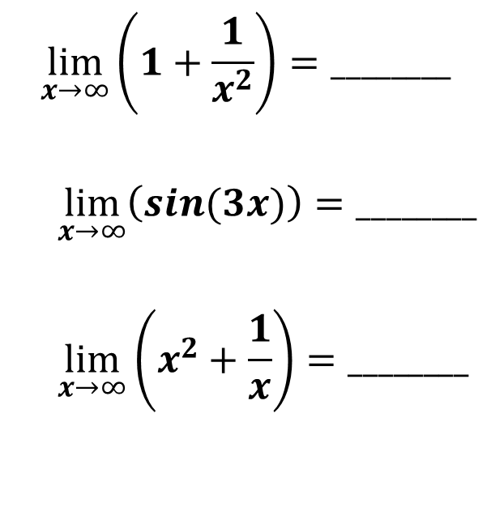

Determining Limits as x→$∞$
$$\lim_{x→∞}\left(2^{x}\right)=________$$
$$\lim_{x→∞}\left(2^{\frac{1}{x}}\right)=________$$
$$\lim_{x→∞}\left(1+\frac{1}{x^{2}}\right)=________$$
$$\lim_{x→∞}\left(sin(3x)\right)=________$$
$$\lim_{x→∞}\left(x^{2}+\frac{1}{x}\right)=________$$

Slide 9
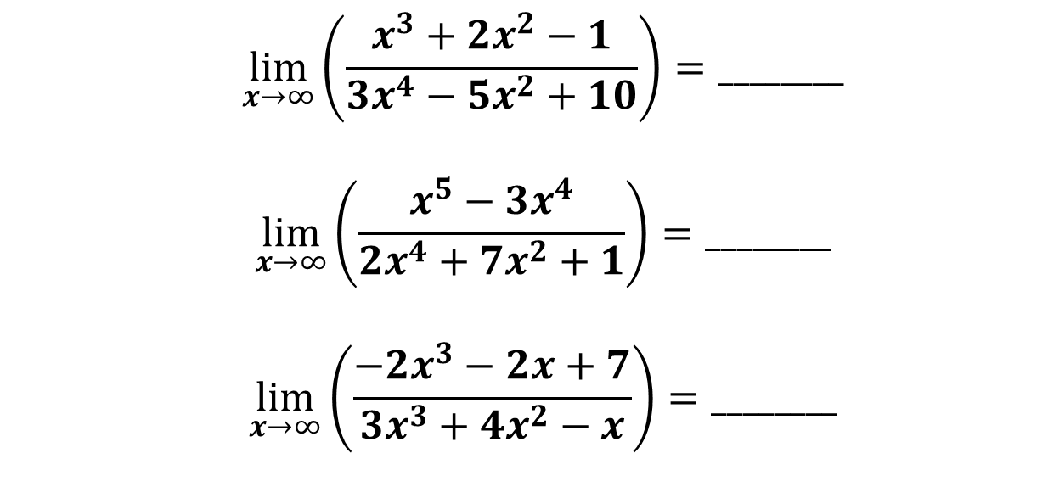
Extra Limit Examples
$$\lim_{x→∞}\left(\frac{x^{3}+2x^{2}−1}{3x^{4}−5x^{2}+10}\right)=________$$
$$\lim_{x→∞}\left(\frac{x^{5}−3x^{4}}{2x^{4}+7x^{2}+1}\right)=________$$
$$\lim_{x→∞}\left(\frac{−{2x}^{3}−2x+7}{3x^{3}+4x^{2}−x}\right)=________$$

Slide 10
Average Rate of Change
If I drive to Florida in 18 hours (1,187 miles), what is my average speed?

Slide 11
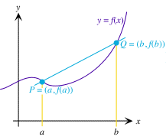
Average Rate of Change (Aroc)
Essentially just slope over the given range
Sample problem:
What is the AROC of
$f\left(x\right)=6x^{3}+2x^{2}+4$ on the interval $[−3, 5]$?

