Slide 1
Evaluating Limits Analytically
Rizzi – Calc BC

Slide 2
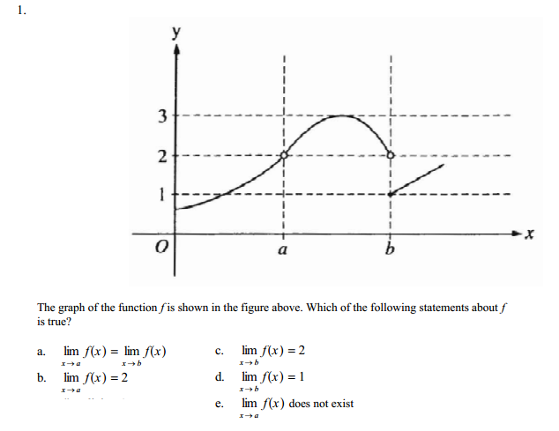
Warm Up
B

Slide 3
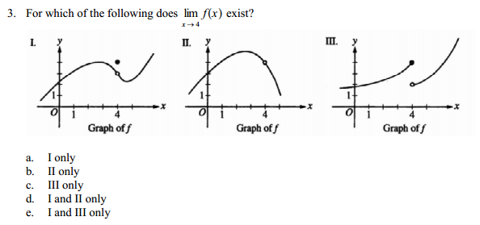
Warm Up 2 – The return of Warm Up
D

Slide 4

Basic Limit Properties
$$\lim_{x→2}{3}=3$$
$$\lim_{x→−4}{x}=−4$$
$$\lim_{x→3}{x^{2}}={\left(3\right)}^{2}=9$$

Slide 5
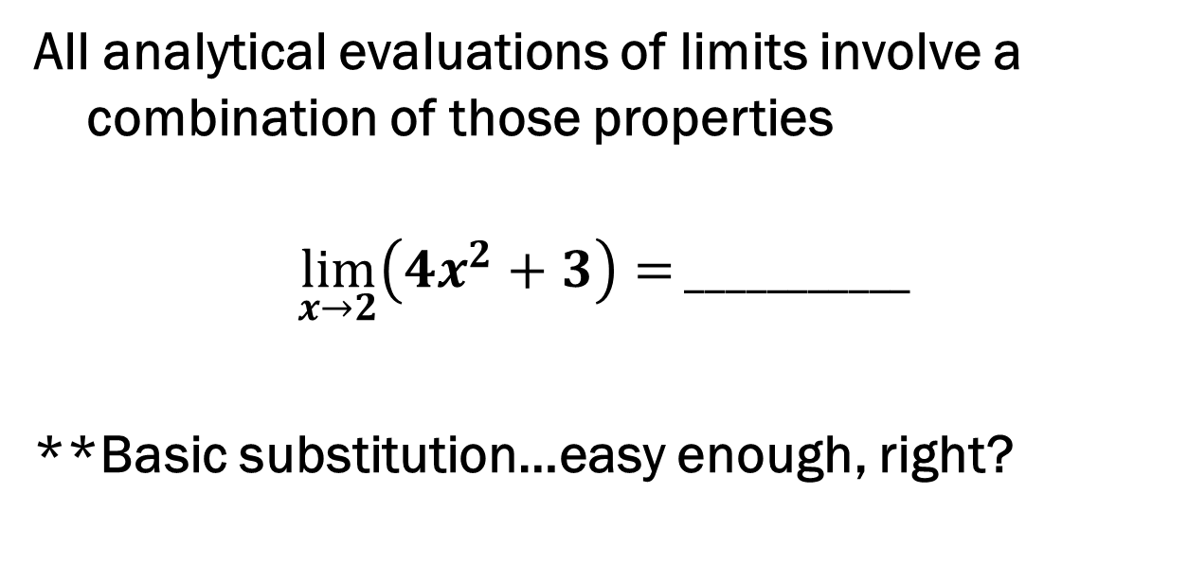
Limit Properties Continued
All analytical evaluations of limits involve a combination of those properties
$$\lim_{x→2}\left(4x^{2}+3\right)=___________$$
**Basic substitution…easy enough, right?

Slide 6

Limit Properties Continued
Theorem 1.2 – Properties of Limits
Let$\lim_{x→c}{f\left(x\right)=L}$and $\lim_{x→c}{g\left(x\right)=K}$
Scalar Multiplier $$\lim_{x→c}\left[b∙f\left(x\right)\right]=bL$$ | Sum or Difference $$\lim_{x→c}\left[f\left(x\right)±g\left(x\right)\right]=L±K$$
Product $$\lim_{x→c}\left[f\left(x\right)g\left(x\right)\right]=LK$$ | Quotient** $$\lim_{x→c}\left[\frac{f(x)}{g(x)}\right]=\frac{L}{K}$$

Slide 7

Practice (with the trigs)
$$\lim_{x→1}{\frac{x^{2}+x+2}{x+1}}=_________$$
$$\lim_{x→π}{xcos\left(x\right)=_________}$$
$$\lim_{x→0}{\frac{1}{3}sin\left(x+\frac{π}{2}\right)}=_________$$

Slide 8
Composite Functions
$$\lim_{x→c}{f\left(g\left(x\right)\right)=f(\lim_{x→c}{g(x))}}$$
This looks like a lot of math jargon, right…?
Examples:
$$\lim_{x→3}{\sqrt[3]{2x^{2}−10}=}$$ | $$\lim_{x→0}{\sin\left(x^{3}−5x+1\right)=}$$

Slide 9

How about this one?
$$\lim_{x→1}{\frac{x^{3}−1}{x−1}=_________}$$
We end up with a $\frac{0}{0}$situation. What does this tell you?

Slide 10

Dividing Out Technique
$$\lim_{x→−3}{\frac{x^{2}+x−6}{x+3}=_________}$$

Slide 11

Rationalizing Technique
$$\lim_{x→0}{\frac{\sqrt{x+1}−1}{x}=_________}$$

Slide 12
Squeeze Theorem
Evaluate the following limit:
$$\lim_{x→0}{x^{2}∗sin\left(\frac{1}{x}\right)}$$
On your GC, graph the following:
$$y_{1}=x^{2}$$
$$y_{2}={−x}^{2}$$
$$y_{3}=x^{2}∗sin\left(\frac{1}{x}\right)$$

Slide 13

Special Trig Limits (memorize these)
$$\lim_{x→0}{\frac{sin(x)}{x}}=1$$
$$\lim_{x→0}{\frac{1−cos\left(x\right)}{x}}=0$$

Slide 14

Solve the Following Trig Limits
$$\lim_{x→0}{\frac{tan(x)}{x}}=$$
$$\lim_{x→0}{\frac{sin (x)}{6x}}=$$
$$\lim_{x→0}{\frac{sin (5x)}{x}}=$$

Slide 15
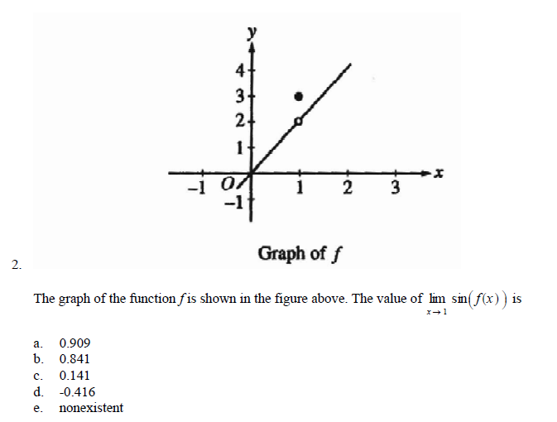
AP-Style Questions
A

Slide 16
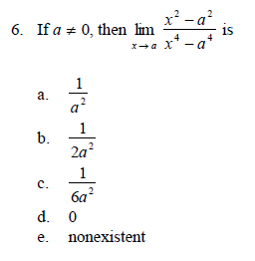
AP-Style Questions
B

