Slide 1
Finding Limits Graphically and Numerically
Rizzi – Calc BC

Slide 2

Simple example
$$f\left(x\right)=\frac{x^{4}−1}{x−1}$$
Find $f\left(2\right)=$
Find $f\left(−1\right)=$
Find $f\left(1\right)=$

Slide 3
Limit Notation
We can’t actually evaluate $f\left(1\right)$ for $f\left(x\right)=\frac{x^{4}−1}{x−1}$
Instead, we can use limit notation to describe where the function goes
$$\lim_{x→1}{\frac{x^{4}−1}{x−1}}=$$

Slide 4

Harder examples
Use a numerical approach to find:
$$\lim_{x→0}{\frac{sin(10x)}{x}}$$
x
y

Slide 5

Harder examples
Use a numerical approach to find:
$$\lim_{x→0}{{(1+x)}^{1/x}}$$
x
y

Slide 6
Limits that Fail to Exist
With your partner, investigate one of the two of these numerically:
$$\lim_{x→0}{\frac{|x|}{x}}$$
$$\lim_{x→0}{sin(1/x)}$$

Slide 7
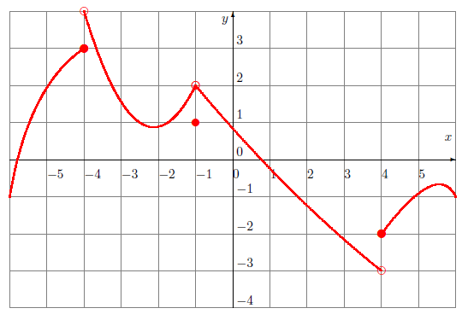
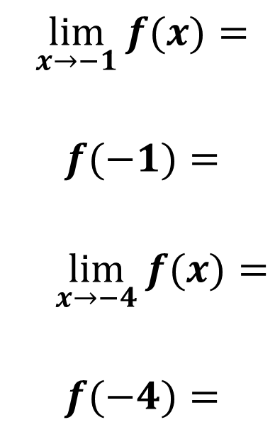
Graphical Limits
$$\lim_{x→−1}{f(x)}=$$
$$f(−1)=$$
$$\lim_{x→−4}{f(x)}=$$
$$f(−4)=$$

